Slide 1
Part-Of-Speech Tagging
Natural Language Processing
Anant Dashpute
SC20M144

Slide 2
Today’s Outline
What is POS Tagging
History
Tag sets
POS tagging approaches
Rule based
Probability based
Text Classification Learning
BOW
Word2Vec introduction
Applications

Slide 3
Example of real life TAG
Anant Rajendra Dashpute.
Do we have tag?
yes
NAME / Father’s Name / Family name(Surname)
How do we know this?

Slide 4
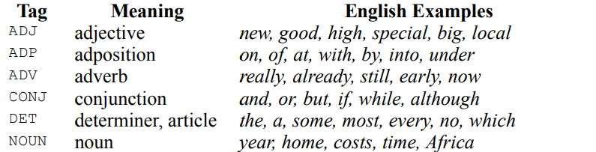
What is POS tagging?
For English - Also known as Grammatical tagging
It is the process of marking up a word based on both its definition and its context.
A simplified form of this is commonly taught to school-age children, in the identification of words as nouns, verbs, adjectives, adverbs, etc.

Slide 5
Looking at History
The Brown Corpus- the first ever corpus (text set)
It consists of about 1,000,000 words of running English prose text, made up of 500 samples from
randomly chosen publications. Each sample is 2,000 or more words (ending at the first sentence
-end after 2,000 words, so that the corpus contains only complete sentences
Use of hidden Markov models
HMMs involve counting cases (such as from the Brown Corpus) and making a table of the probabilities of certain sequences
Dynamic programming methods
algorithms to solve the same problem in vastly less time. Their methods were similar to the Viterbi algorithm known for some time in other fields
Unsupervised taggers
involve working from a pre-existing corpus to learn tag probabilities
Reference –Wikipedia

Slide 6
Tag sets
POS tags are also known as word classes, morphological classes, or lexical tags.
Common -9 parts of speech in English noun, verb, article, adjective, preposition, pronoun, adverb,
conjunction, and interjection.
However ,If you want to go for sentence completion problem you will need some extra categories Like plural, possessive, and singular forms or tenses also
Associating each word in a sentence with a proper POS (part of speech) is known as POS tagging or POS annotation
Reference –Wikipedia

Slide 7
Some Known Tag sets
Original Brown corpus used a large set of 87 POS tags.
Most common in NLP today is the Penn Treebank set of 45 tags.
Reduced from the Brown set
Widely used
The C5 tag set used for the British National Corpus (BNC) has 61 tags.
Reference –Wikipedia

Slide 8
The POS tagger in the NLTK library
CC coordinating conjunction
CD cardinal digit
DT determiner
EX existential there (like: “there is” … think of it like “there exists”)
FW foreign word
IN preposition/subordinating conjunction
JJ adjective ‘big’
JJR adjective, comparative ‘bigger’
JJS adjective, superlative ‘biggest’
LS list marker 1)
MD modal could, will
NN noun, singular ‘desk’
NNS noun plural ‘desks’
NNP proper noun, singular ‘Harrison’
NNPS proper noun, plural ‘Americans’
PDT predeterminer ‘all the kids’
POS possessive ending parent’s
PRP personal pronoun I, he, she
PRP$ possessive pronoun my, his, hers
RB adverb very, silently,
RBR adverb, comparative better
RBS adverb, superlative best
RP particle give up
TO, to go ‘to’ the store.
UH interjection, errrrrrrrm
VB verb, base form take
VBD verb, past tense took
VBG verb, gerund/present participle taking
VBN verb, past participle taken
VBP verb, sing. present, non-3d take
VBZ verb, 3rd person sing. present takes
WDT wh-determiner which
WP wh-pronoun who, what
WP$ possessive wh-pronoun whose
WRB wh-abverb where, when

Slide 9
POS Tagging Approaches
Rule-Based: Human crafted rules based on lexical and other linguistic knowledge.
Learning-Based:
Statistical models:
Hidden Markov Model (HMM),
Maximum Entropy Markov Model (MEMM),
Conditional Random Field (CRF)
Rule learning:
Transformation Based Learning (TBL)
Neural networks:
Recurrent networks like Long Short Term Memory (LSTMs)
Generally, learning-based approaches have been found to be more effective overall, taking into account the total amount of human expertise and effort involved.

Slide 10
Rule-Based Tagging
Algorithm
Start with a dictionary
Assign all possible tags to words from the dictionary
Write rules by hand to selectively remove tags
Leaving the correct tag for each word.
Hand written rule
Ex: “If an ambiguous/unknown word ends with the suffix ‘ing’ and is preceded by a Verb, label it as a Verb”.
Dance + ‘ing’, -> Dancing /Verb
Ex. - ENGTWOL Tagging

Slide 11
Learning-Based: Probabilistic Sequence Models
Probabilistic sequence models allow integrating uncertainty over multiple, interdependent classifications and collectively determine the most likely global assignment.
Two standard models
Hidden Markov Model (HMM) & Maximum Entropy Markov Model (MEMM)
Conditional Random Field (CRF)

Slide 12
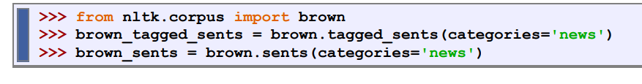
Problem in Sequence Tagging
We see that the tag of a word depends on the word and its context within a sentence.(ambiguities Sequence)
1) She saw a bear/noun. 2) Your efforts will bear/verb fruit.
For this reason, we work with data at the level of tagged sentences
Example:

Slide 13
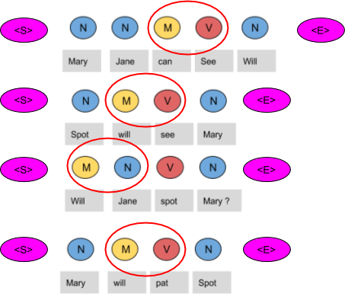
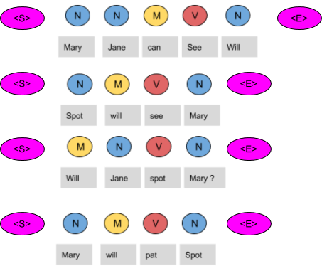
Sliding window based N gram tagging
Unigram Tagger Bigram Tagger

Slide 14
Sequence to Sequence Modelling
Part of Speech labelling
String of Words → String of POS Tags •
The choice of tag is dependent on both previous words and previous tags
What is Sequence?
Noun verb pronoun det

Slide 15
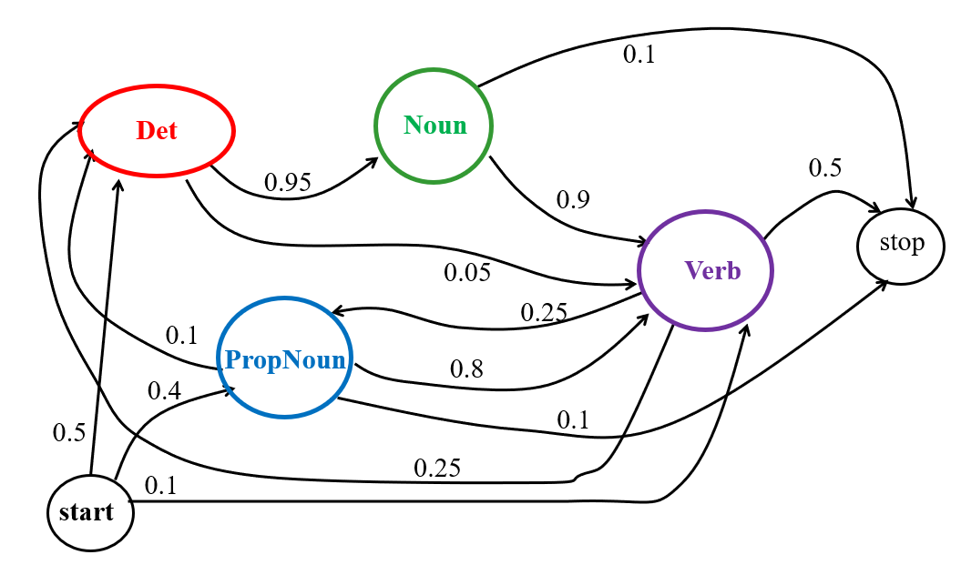
Markov Model / Markov Chain
A finite state machine with probabilistic state transitions.
Makes Markov assumption that next state only depends on the current state and independent of previous history.
POS MARKOV MODEL
Referred from-Raymond J. Mooney Slides
University of Texas at Austin

Slide 16
Markov chain Problems
A weighted finite-state automaton adds probabilities
The sum of the probabilities must sum to one
Markov chains can’t represent inherently ambiguous problems
Useful for assigning probabilities to unambiguous sequences
What are ambiguities Sequence?
1) She saw a bear. 2) Your efforts will bear fruit.
The word bear in the above sentences has completely different senses,
but more importantly one is a noun and other is a verb.

Slide 17
First-order observable Markov Model
A set of states
Q = q₁, q₂…q_{N;} the state at time t is q_{t}
Transition probabilities:
a set of probabilities A = a₀₁a₀₂…a_{n1}…a_{nn}.
Each a_{ij} represents the probability of transitioning from state i to state j
The set of these is the transition probability matrix A
Current state only depends on previous state

Slide 18
Hidden Markov Model (HMM)
special case of Bayesian inference Also known as Stochastic technique
Probabilistic generative model for sequences.
Assume probabilistic transitions between states over time
Assume a probabilistic generation of tokens from states (e.g. words generated for each POS).

Slide 19
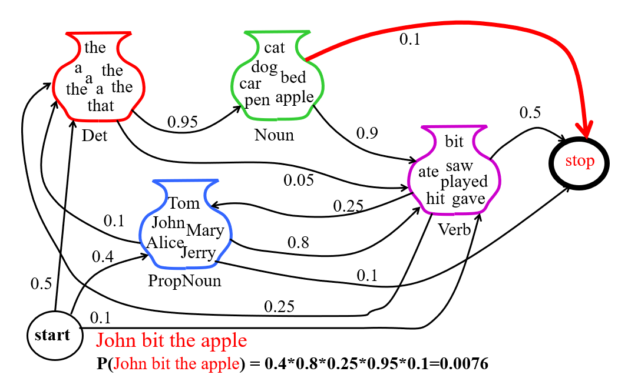
EXAMPLE –Sequence(Pronoun, Verb, DET, NOUN)

Slide 20
How HMM generate a sequence
To generate a sequence of T observations:
O = o₁ ,o₂ ,… o_{T}
Algorithms
Set initial state q₁=s₀
For t = 1 to T
Transit to another state q_{t+1}=s_{j} based on transition
distribution a_{ij} for state q_{t}
Pick an observation o_{t} =v_{k} based on being in state q_{t} using distribution b_{qt}(k)

Slide 21
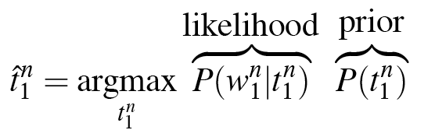
HMM Taggers
Two kinds of probabilities
A transition probabilities (PRIOR)
B observation likelihoods (LIKELIHOOD)
HMM Taggers choose the tag sequence which maximizes the product of word likelihood and tag sequence probability

Slide 22
HMM Function
Goal: maximize P(word|tag) x P(tag|previous ‘n’ tags)
P(word|tag)
word/lexical likelihood
probability that given this tag, we have this word
modeled through language model (word-tag matrix)‏
P(tag|previous n tags)‏
tag sequence likelihood
probability that this tag follows these previous tags
modeled through language model (tag-tag matrix)‏
Lexical information
Syntagmatic information

Slide 23
HMM: Observation Likelihood Naïve Solution
Consider all possible state sequences, Q, of length T
Compute the probability of a given state sequence from A, and multiply it by the probabilities of generating each of given observations in each of the corresponding states in this sequence to get
P(O,Q| λ) = P(O| Q, λ) *P(Q| λ) .
Sum this over all possible state sequences to get
P(O|λ).
Computationally complex: O(TN^{T} ).

Slide 24
HMM: Observation Likelihood Efficient Solution
Due to the Markov assumption, the probability of being in any state at any given time t only relies on the probability of being in each of the possible states at time t−1.
Forward Algorithm: Uses dynamic programming to exploit this fact to efficiently compute observation likelihood in O(TN ²) time.
Compute a forward trellis that compactly and implicitly encodes information about all possible state paths

Slide 25
Forward Trellis
Continue forward in time until reaching final time point and sum probability of ending in final state.
s₁
• • •
s₂
• • •
•
•
•
•
•
•
•
•
•
•
•
•
•
•
•
s₀
• • •
s_{F}
s_{N}
• • •
t₁
t₂
t₃
t_{T-1}
t_{T}

Slide 26
Forward Step
Consider all possible ways of getting to s_{j} at time t by coming from all possible states s_{i} and determine probability of each.
Sum these to get the total probability of being in state s_{j} at time t while accounting for the first t −1 observations.
Then multiply by the probability of actually observing o_{t} in s_{j.}
s₁
a_{1j}
s₂
a_{2j}
•
•
•
a_{2j}
s_{j}
a_{Nj}
s_{N}
α_{t-1}(i)
α_{t}(i)

Slide 27
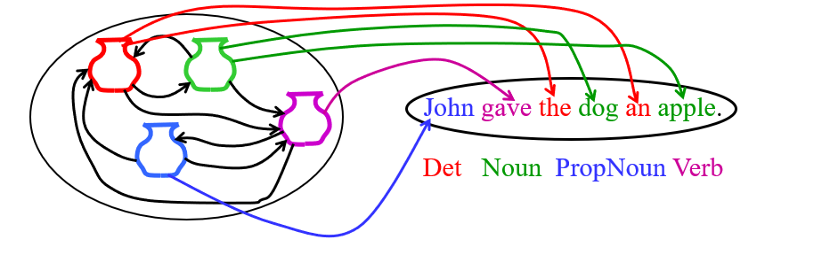
Dynamic Approach Most Likely State Sequence
Given an observation sequence, O, and a model, λ,
what is the most likely state sequence, Q=q₁,q₂,…q_{T}, that generated this sequence from this model?
Used for sequence labeling, assuming each state corresponds to a tag, it determines the globally best assignment of tags to all tokens in a sequence using a principled approach grounded in probability theory.
Some Sequence

Slide 28
Better solution
Obviously, could use naïve algorithm based on examining every possible state sequence of length T.
Dynamic Programming can also be used to exploit the Markov assumption and efficiently determine the most likely state sequence for a given observation and model.
Standard procedure is called the Viterbi algorithm (Viterbi, 1967) and also has O(N ²T) time complexity.

Slide 29
Viterbi Scores
Recursively compute the probability of the most likely subsequence of states that accounts for the first t observations and ends in state s_{j}.
Also record “back pointers” that subsequently allow back-tracing the most probable state sequence.
bt_{t}(j) stores the state at time t-1 that maximizes the probability that system was in state s_{j} at time t (given the observed sequence).

Slide 30
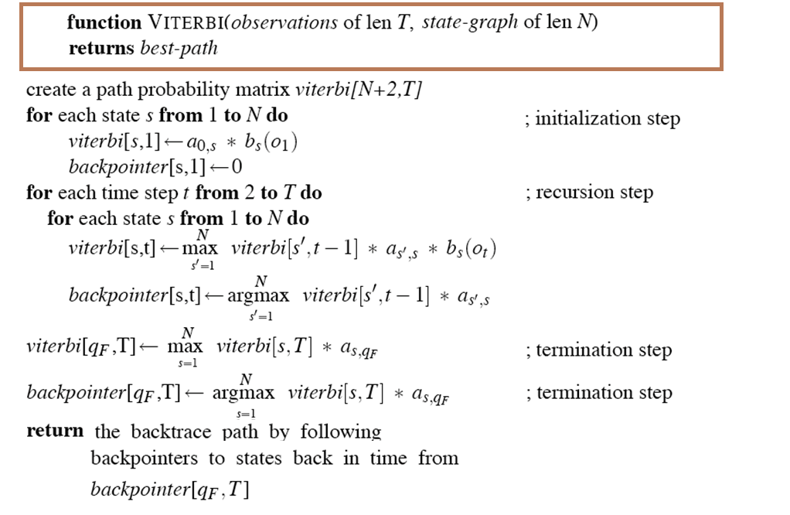
Viterbi algo
For finding best path

Slide 31
Viterbi Algorithm
Let T = # of part-of-speech tags
W = # of words in the sentence
/* Initialization Step */
for t = 1 to T
Score(t, 1) = Pr(Word₁| Tag_{t}) * Pr(Tag_{t}| φ)
BackPtr(t, 1) = 0;
/* Iteration Step */
for w = 2 to W
for t = 1 to T
Score(t, w) = Pr(Word_{w}| Tag_{t}) *MAX_{j=1,T}(Score(j, w-1) * Pr(Tag_{t}| Tag_{j}))
BackPtr(t, w) = index of j that gave the max of above
/* Sequence Identification */
Seq(W ) = t that maximizes Score(t,W )
for w = W -1 to 1
Seq(w) = BackPtr(Seq(w+1),w+1)

Slide 32
Viterbi Back-trace
s₁
• • •
s₂
• • •
•
•
•
•
•
•
•
•
•
•
•
•
•
•
•
s₀
• • •
s_{F}
s_{N}
• • •
t₁
t₂
t₃
t_{T-1}
t_{T}
Most likely Sequence: s₀ s_{N} s₁ s₂ …s₂ s_{F}

Slide 33
COMPARISION
TIME COMPLEXITY

Slide 34
Problems with Sequence Labeling as Classification
Not easy to integrate information from category of tokens on both sides.
Difficult to propagate uncertainty between decisions and “collectively” determine the most likely joint assignment of categories to all of the tokens in a sequence.

Slide 35
HMM Learning
Supervised Learning: All training sequences are completely labeled (tagged).
Naïve Bayes and Bayesian Networks
Logistic Regression / Maximum Entropy (MaxEnt)
Perceptron and Neural Networks
Unsupervised Learning: All training sequences are unlabeled (but generally know the number of tags, i.e. states).
Nearest-Neighbor / Instance-Based
Maximum Likelihood
Expectation Maximization Algorithm
Semi supervised Learning: Some training sequences are labeled, most are unlabeled.

Slide 36
Supervised HMM Training
Training Sequences
John ate the apple
A dog bit Mary
Mary hit the dog
John gave Mary the cat.
Supervised
HMM
Training
.
.
.
Det Noun PropNoun Verb

Slide 37
Supervised Parameter Estimation
Estimate state transition probabilities based on tag bigram and unigram statistics in the labeled data.
Estimate the observation probabilities based on tag/word co-occurrence statistics in the labeled data.
Use appropriate smoothing if training data is sparse.

Slide 38
Unsupervised Most Likelihood training
Training Sequences
ah s t e n
a s t i n
oh s t u n
eh z t en
HMM
Training
.
.
.
Austin
Given an observation sequence, O, what set of parameters, λ, for a given model maximizes the probability that
this data was generated from this model (P(O|λ))

Slide 39
Expectation Maximization Algorithm
Iterative method for learning probabilistic categorization model from unsupervised data.
Initially assume random assignment of examples to categories.
Learn an initial probabilistic model by estimating model parameters θ from this randomly labeled data.
Iterate following two steps until convergence:
Expectation (E-step): Compute P(c_{i} | E) for each example given the current model, and probabilistically re-label the examples based on these posterior probability estimates.
Maximization (M-step): Re-estimate the model parameters, θ, from the probabilistically re-labeled data.

Slide 40
Semi-Supervised Learning
EM algorithms can be trained with a mix of labeled and unlabeled data.
EM basically predicts a probabilistic (soft) labeling of the instances and then iteratively retrains using supervised learning on these predicted labels (“self training”).
EM can also exploit supervised data:
1) Use supervised learning on labeled data to initialize the parameters (instead of initializing them randomly).
2) Use known labels for supervised data instead of predicting soft labels for these examples during retraining iterations.

Slide 41
Classification Learning

Slide 42
Text Classification examples
Spam/Ham Email Classification
News type Classification (sport, Bollywood, political, etc.)
Sentiment Analysis
Product ratings
Recommendation Based on Top Ratings

Slide 43
Typical machine learning addresses the problem of classifying a feature-vector description into a fixed number of classes.
There are many standard learning methods for this task:
Decision Trees and Rule Learning
Naïve Bayes and Bayesian Networks
Logistic Regression
Perceptron and Neural Networks
Support Vector Machines (SVMs)
Nearest-Neighbor / Instance-Based

Slide 44
Features and Embeddings
Samples are movie reviews:
A few sentences of text
A class: 1-5 (1 very bad, 5 very good)
What are the Features?
List of features → Category
Category: “small” finite discrete # of classes
E.g. Language ID, POS tag, Movie genre
Features: list of real numbers
All samples must have same # of features

Slide 45
How to represent words
One big vector for whole movie review
Lots of zeros and few ones
Might be 1000, 10,000 wide (or more) •
Often called “bag of words”
Not care about word order
Not care about # of occurrences of word
Same length vector independent of length of review
Decide on vocabulary size + _other_
Vocab should be most frequent/relevant words in corpus
Including very high frequency words?
Only content words?
Only words appearing more than once?

Slide 46
Bag of Words
a text (such as a sentence or a document) is represented as the bag (multiset) of its words, disregarding grammar and even word order but keeping multiplicity.
Reviews are “similar” if vectors are similar
Similar means similar word distribution
e.g. simple difference, edit difference, cos similarity
Word similarity (“love” vs “hate” vs “like”)
Discrete Classes
`Business [1,0,0]
Sports [0,1,0]
Entertainment [0,0,1]
Known as “one hot” representations

Slide 47
Word2vec
uses a neural network model to learn word associations from corpus
Assign every unique word -> numerical vector
Once trained,
such a model can detect synonymous words
Word2vec can utilize either of two model architectures to produce a distributed representation of words: continuous bag-of-words (CBOW)
continuous bag-of-words architecture,
the model predicts the current word from a window of surrounding context words. The order of context words does not influence prediction (bag-of-words assumption).

Slide 48
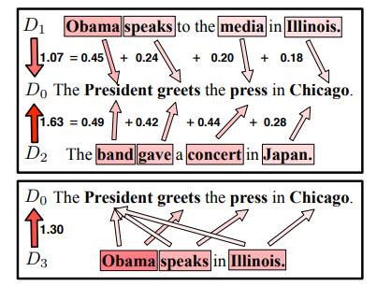
Word Differences
“like” and “love” more similar than “like” and “hate”
Word Embeddings
Dense (not sparse) representations
Distance metrics more “meaningful” ??

Slide 49
Some Applications

Slide 50
Information Extraction
Identify phrases in language that refer to specific types of entities and relations in text.
Named entity recognition is task of identifying names of people, places, organizations, etc. in text.
people organizations places
Michael Dell is the CEO of Dell Computer Corporation and lives in Austin Texas.
Extract pieces of information relevant to a specific application, e.g. used car ads:
make model year mileage price
For sale, 2002 Toyota Prius, 20,000 mi, $15K or best offer. Available starting July 30, 2006.

Slide 51
Semantic Role Labeling
For each clause, determine the semantic role played by each noun phrase that is an argument to the verb.
agent patient source destination instrument
John drove Mary from Austin to Dallas in his Toyota Prius.
The hammer broke the window.
Also referred to a “case role analysis,” “thematic analysis,” and “shallow semantic parsing”

Slide 52

Summary
POS Tagging
Some History
Tag sets
N-gram Tagging
Hidden Markov model
Viterbi algo
HMM class learning
Applications
Classification Learning
Bag of words
word2vec
Applications

